Slide 1

BrovaH (Marketplace & Recommendation System for Fashion Styles)
Presented by:
Geeks Team

Slide 2
Guidelines
Problem Definition
Previous Works
Vision
Idea
Software and AI-based Solution (BrovaH Marketplace)
BrovaH Marketplace Features
Future Works

Slide 3
Problem Definition
The spread of COVID-19 virus due to crowding out while there is a need every season for clothes shopping in malls and clothing stores.

Slide 4
Previous Works
ViSenze : https://www.visenze.com
3dLook : https://3dlook.me

Slide 5
Vision
Helping people through facilitate their needs for clothes shopping every season during the COVID-19 pandemic.
Isolation of wellbeing & reducing the spread of COVID-19 virus due to crowding out while clothes shopping in malls and clothing stores.

Slide 6
Idea
Therefore, we decide to merge the previous work of 3dLook with ViSenze and innovate in a new designed recommendation system that represents an AI-based solution that provides a Marketplace called “BrovaH”.

Slide 7
Software and AI-based Solution (BrovaH Marketplace)
BrovaH Marketplace is a recommendation system and marketplace like Alibaba, PULL&BEAR, and Zara that designed to provide online consumers with the most personalized (Style Matching feature) and engaging shopping experience, and Clothes Stores & Retailers – with the knowledge about how their customers actually look like.
In addition to “Online BrovaH“ feature that makes Brova online and touchless solution due to the COVID-19 pandemic.

Slide 8
BrovaH Marketplace Features (Value Propositions)
For Consumers:
BrovaH clothes marketplace (Mobile & Website).
Recommendation System for fashion style.
Can search for a personal style by uploading image.
Online Clothes Brova.
Customers buy clothes & make orders online from BrovaH marketplace.
Email or SMS subscription for new added fashion styles.
Perks & Benefits for receiving new offers/promotions (Set by retailers)
For Retailers:
Clothes Stores and Retailers can sell their products via BrovaH marketplace.
Business Marketing/Advertising for Retailers.

Slide 9
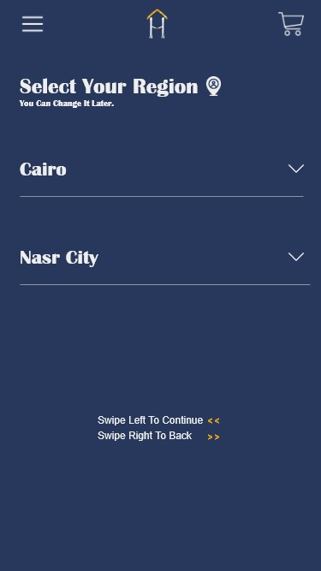
Fashion Recommendation by stores in your region

Slide 10
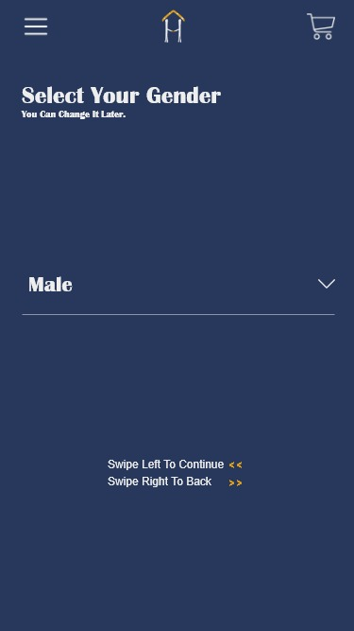
Fashion Recommendation For Specific Gender

Slide 11
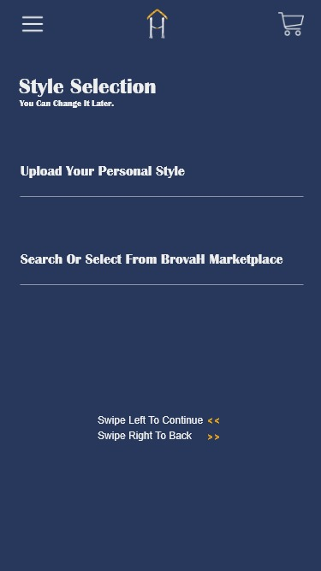
Style Selection

Slide 12
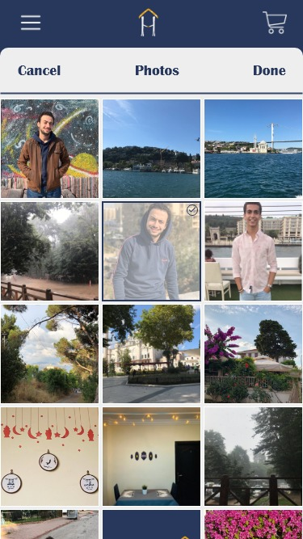
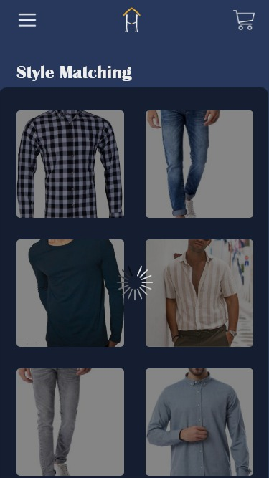
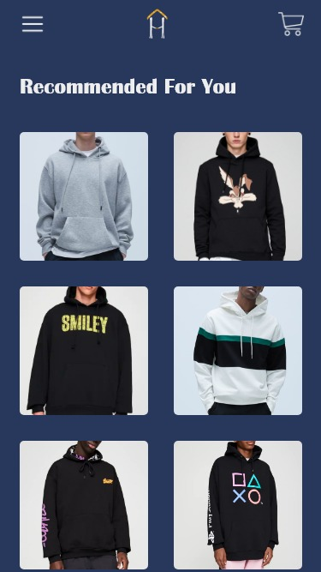
Fashion Recommendation By Gender & Region

Slide 13
Style Matching Feature (Upload your personal style)

Slide 14
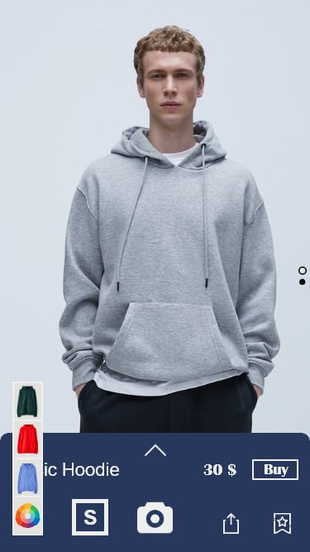
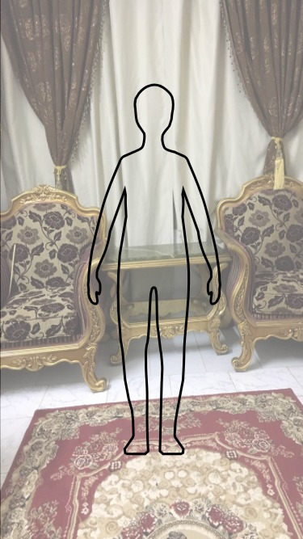
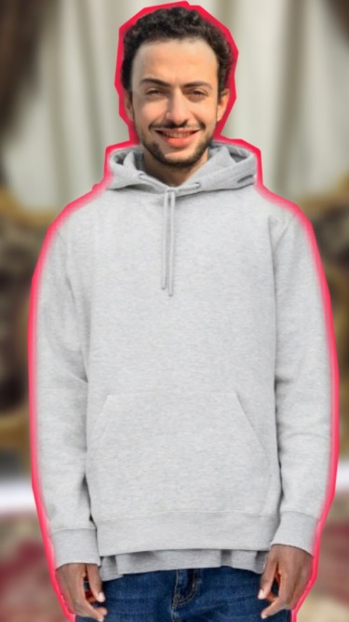
Online BrovaH Feature

Slide 15
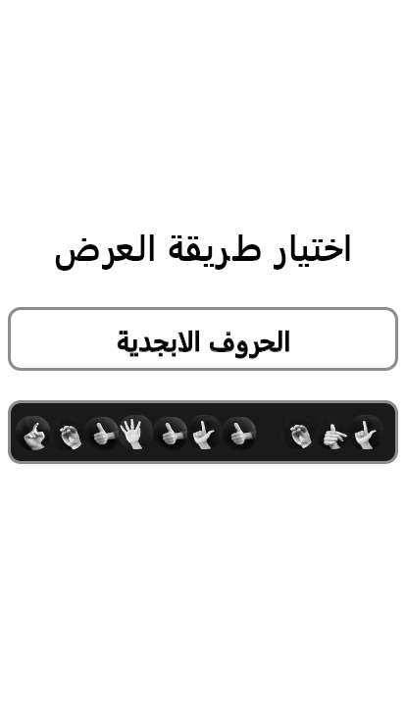
Customer Relationships
Onboard local clothes retailers.
Maintain retail relationship.
Consumer Awareness and Recommendation.
Ensure Ease of use.
Ensure advantages are honored.

Slide 16
Future Works
We prepared a Business Model Plan for this project and intend to make integration with Clothes Stores and Retailers so that they can sell their products and Business marketing/Advertising via BrovaH marketplace.

